Slide 1

SRM INSTITUTE OF SCIENCE AND TECHNOLOGY
COLLEGE OF ENGINEERING AND TECHNOLOGY
DEPARTMENT OF NETWORKING AND COMMUNICATIONS
21CSC202J-Operating Systems, Mini-Project Presentation
-:FCFS SCHEDULING VISUALIZER:-
AKANKSHA MISHRA [RA2211003011513]
ADITYA ROY [RA2211003011539]
APARIJIT CHAKRABORTY [RA2211003011540]
BY-SA
Guided by:
Dr. ARUNA M.
Assistant Professor
Department of Computing Technologies

Slide 2
Contents:
Title Slide
Contents
Introduction
Methodology
Common CPU Scheduling Algorithms
FCFS Scheduling Algorithm
How FCFS Works?
Beneﬁts of FCFS
FCFS Visualizer Interface
Display
Limitations of FCFS
Conclusion
Bibliography
Thank You
1
2
3
4
5
6
7
8
9
10
11
12
13
14

Slide 3
Introduction:
In the ever-evolving realm of operating systems and computer science, efficient CPU scheduling is a fundamental concern. CPU scheduling algorithms determine how a computer's central processing unit manages the e ecution of multiple processes, profoundly impacting system performance and user e perience.
Among these algorithms, First-Come-First-Serve (FCFS) stands as one of the simplest and most intuitive methods. FCFS operates on the principle of ﬁrst-come, ﬁrst-served, meaning that processes are e ecuted in the order they arrive in the queue. Our visualizer offers a unique opportunity to e plore and interact with the FCFS scheduling algorithm. Users will gain a
hands-on e perience of how FCFS works, from adding processes to the queue to visualizing their e ecution. This project is not merely a theoretical e ploration; it's a practical tool to assist students, educators, and system administrators in comprehending the real-world implications of different scheduling methods.

Slide 4
Methodology:
The project has been developed using the following methodology:
Requirements Analysis: Gathering and documenting the requirements for the simulator. We had to be clear about the concepts used in this project. We apply these concepts and logic to make the project
Design: Creating a detailed design of the simulator's architecture, user interface, and scheduling algorithm implementation.
Implementation: Developing the simulator and algorithms using suitable programming language(s). We have used HTML, CSS and Javascript in our project.
Testing: Conducting testing to ensure the simulator functions correctly. Without the repeated testing this project has gone through, it would not be possible to create such a sleek, user-friendly interface.

Slide 5
Common CPU Scheduling Algorithms:
Shortest Job First (SJF): SJF is a non-preemptive scheduling algorithm where the CPU is assigned to the process with the shortest burst time ﬁrst. It minimizes average waiting time, making it efficient for batch systems with known job durations. However, predicting accurate burst times can be challenging in practice.
Priority Scheduling: Priority scheduling assigns priorities to processes, and the CPU serves the highest priority process ﬁrst. It's suitable for scenarios where certain processes require immediate attention. However, it can lead to priority inversion issues if not managed properly.
Round Robin (RR): RR is a preemptive scheduling algorithm where each process gets a ﬁed time quantum to e ecute, cycling through the queue. It ensures fairness and responsiveness for all processes but may lead to overhead in conte t switching with very short time quanta.

Slide 6
FCFS Scheduling Algorithm
FCFS is one of the simplest and most intuitive CPU scheduling algorithms used in operating systems. It operates on the principle that processes are e ecuted in the order they arrive in the ready queue. When a process enters the queue, it is placed at the end, and the CPU is allocated to the process at the front of the queue.
FCFS has the advantage of being easy to implement and understanding, making it a suitable choice for educational purposes and scenarios where simplicity is desired. However, it comes with notable limitations. One signiﬁcant drawback is the potential for the "convoy effect" – where a long process at the front of the queue can hold up shorter processes behind it, leading to inefficiency.
Additionally, FCFS does not consider process priority or burst time, making it less adaptable to varying workloads. It also lacks preemption, which means that once a process starts, it cannot be interrupted even if a higher-priority process arrives later.

Slide 7
How FCFS Works?
Queue Formation: When processes are created or arrive in the system, they are added to the ready queue, forming a linear queue structure. The order in which they arrive in the queue is crucial, as it determines the order of e ecution.
Process Eecution: The CPU is allocated to the process at the front of the queue. The selected process runs until it either completes its e ecution or enters a waiting state (e.g., for I/O operations). If a process enters a waiting state, it is temporarily removed from the CPU and placed back in the queue when it becomes ready.
Completion or Termination: When a process completes its e ecution, it is removed from the queue. The CPU then moves on to the ne t process in the queue.

Slide 8
Beneﬁts of FCFS
Simplicity: FCFS is easy to understand and implement. Its simplicity makes it an e cellent choice for educational purposes, helping students grasp fundamental scheduling concepts without the comple ities of more advanced algorithms.
No Priority Disputes: FCFS ensures a fair and straightforward allocation of CPU time, as processes are e ecuted in the order they arrive. This eliminates priority disputes or the need for comple priority calculations, simplifying system management.
Deterministic Behavior: FCFS provides deterministic behavior, as the order of e ecution is solely based on arrival time. This predictability can be advantageous in certain environments where process order is crucial.
Suitable for Certain Workloads: In cases where the workload predominantly consists of long, CPU-bound processes with similar burst times, FCFS can provide reasonable performance.

Slide 9
FCFS Visualizer Interface
We have created a fun, user friendly interface that provides an interactive e perience.
At the top, we can add the process ID, arrival time and burst time of each process.
Below that, we have buttons to add the process, delete the process, calculate the results (average waiting time and average turnaround time) or visualise.
The processes are displayed in a table like format below followed by the results calculated.
The Gantt chart at the bottom can be used to visualise the process. Different colours are added to each process to make the it look more e citing and appealing.

Slide 10
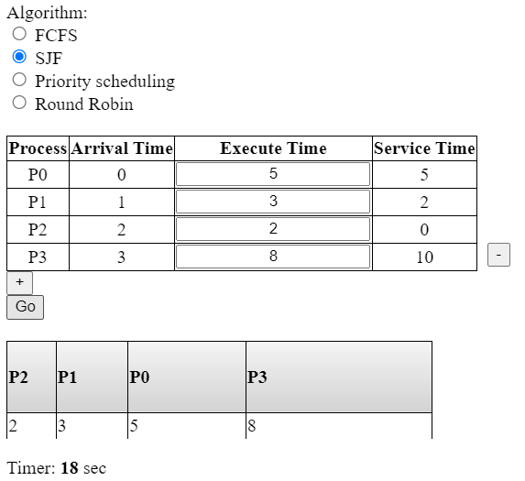
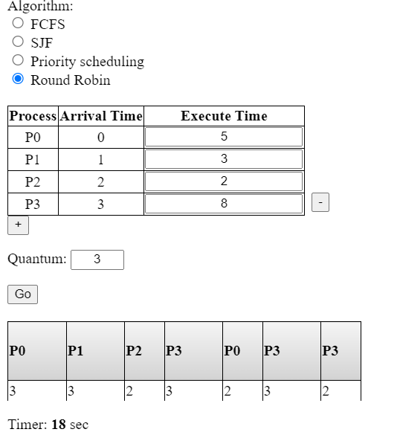
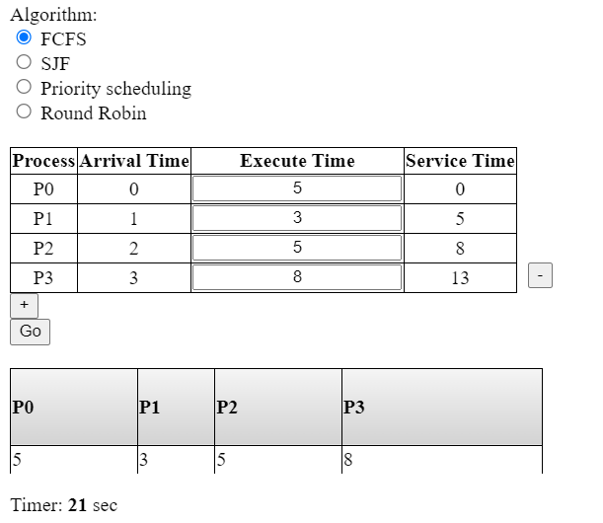
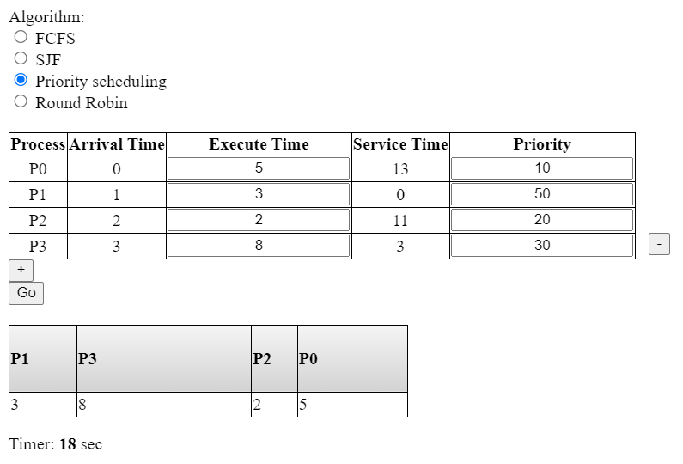
OUTPUTS:
SJF
Priority Scheduling
Round Robin
FCFS

Slide 11
Limitations of FCFS
Convoy Effect: In FCFS, a long process that arrives ﬁrst can hold the CPU for an e tended period, causing short processes to wait. This situation, known as the convoy effect, can lead to inefficient resource utilization.
No Consideration for Process Priority: FCFS doesn't consider the priority of processes. This can be problematic in situations where certain processes need to be e ecuted with higher priority due to their importance or urgency.
No Consideration of Burst Times: FCFS doesn't take into account the e pected burst times of processes. Shorter processes should ideally be scheduled before longer ones to reduce turnaround times.
Starvation: There is a possibility of process starvation, where a process may never get CPU time if longer processes keep arriving in the queue, continually pushing it back.
Lack of Adaptability: FCFS doesn't adapt to changing circumstances or priorities. It operates based solely on the order of process arrival.

Slide 12
Conclusion
In this project, we set out to create a platform that would allow us to e plore and analyse the intricacies FCFS process scheduling algorithm used in operating systems. As we conclude this mini project, it is evident that we have met our goals and objectives:
1. Understanding and Implementation: The project involved a comprehensive understanding of FCFS scheduling algorithm. We successfully implemented this algorithm, allowing users to
e perience it in action.
User-Friendly Interface: The user interface of our simulator was designed to be user-friendly, enabling users to conﬁgure processes, set scheduling parameters, and visualize the simulation with ease. This interface has facilitated a hands-on learning e perience.
Performance Metrics: The inclusion of performance metrics, such as arrival time, burst time, average waiting time and average turnaround time, helped us evaluate and observe the efficiency and effectiveness of the algorithm. We also got to visualise the Gantt chart.
Real-Time Simulation: Users were able to e perience real-time process visualization, providing a dynamic and interactive learning environment.

Slide 13
Bibliography
https://www.futurelearn.com/info/courses/computer-systems/0/steps/53513
https://www.geeksforgeeks.org/cpu-scheduling-in-operating-systems/
https://www.javatpoint.com/cpu-scheduling-algorithms-in-operating-systems
https://www.guru99.com/cpu-scheduling-algorithms.html
https://www.scaler.com/topics/operating-system/cpu-scheduling/
https://www.shiksha.com/online-courses/articles/cpu-scheduling-algorithm-operating-sys tem/
Operating Systems Concepts 10th edition by ABRAHAM SILBERSCHATZ, PETER BAER GALVIN & GREG GAGNE

Slide 14

Thank You!

